Slide 1
Uniform Convergence may be Unable to Explain Generalization in Deep Learning
Jichen Dai
10/01/2020

Slide 2
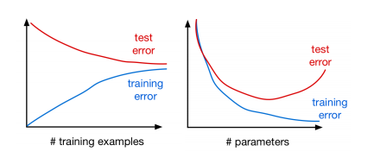
Goal of the paper
1. Revealed the defect of uniform convergence based generalization bound.
2. Call to develop technique that don't rely on algorithms (rely on uniform covergence)
Generalization bound: the boundary of a model's generalization ability.
generilization bound >= test_error - tarining_error
So far, a variety of generalization bound has been developed,
but they are all based on Uniform Covergence.

Slide 3
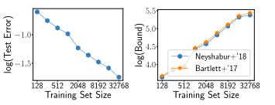
Methods & Results
First, defined new rule:
Generalization bound should decrease as the data size increase.
Method: Analyzed 3 overparameterized model:
1. linear classifier
2. ReLU neural network
3. conjecture in overparameterized deep networks
Results:

Slide 4
Advantage of this paper
NeurIPS 2019 Outstanding New Directions Paper Award
Advantage:
Indicated a new direction for the academic world.
Reflect on the current research trend instead of following it.
What lessons we can learn:
Critically think about existing theories.
Jump out and consider the big picture.

Slide 5
What further work we can do?
Try to understand generalization in other ways.
such as algorithmic stability
Try to develop generalization bound without depend on algorithm (avoid using uniform covergence)

Slide 6
Jichen Dai
10/01/2020

